Slide 1




ULTRASONIC RADAR USING ARDUINO WITH MATLAB
Raj Kumar Goel Institute of Technology
(ISO 9001:2015 Certified)
5 –Km. Stone, Delhi – Meerut Road, Ghaziabad (U.P. – 201003)
DEPARTMENT OF ECE
Under the Supervision of-
Project Guide: Mr. Nitish Vashishth
Designation: Assistant Professor
Project Co-Guide (if any): Dr. Puneet C. Srivastava
Designation: Professor
Presented By-
VATSAL AGARWAL 1900330310080
SHIVAM KUMAR 1900330310064
DEVANSH CHAUHAN 1900330310024
4th Year (2019-23) , B.Tech. (ECE)
DEPARTMENT OF ELECTRONICS AND COMMUNICATION ENGINEERING (NBA)

Slide 2
Index
Introduction
Components
Circuit Diagram
Software Incorporated
MATLAB Code
Arduino Code
Applications in Modern World
References
Department of Electronics And Communication Engineering (NBA)

Slide 3
Introduction:
It can detect any object in the path with the help of an ultrasonic sensor. Ultrasonic sensors rotate over the servo motor and almost cover all directions in rotatory motion. it uses in distance measuring and object detection. Radar system using the ultrasonic sensor to detect the object in front of the sensor. and servo motor help to cover the distance by rotating itself slowly

Slide 4
Components Required:-
Arduino Uno
Servo motor
Processing Software
Breadboard
Jumper wire
Arduino cable
Ultrasonic sensor

Slide 5
COMPONENTS
Servo Motor
A servomotor is a rotary actuator that allows for precise control of angular position, velocity and acceleration. It consists of a suitable motor coupled to a sensor for position feedback. It also requires a relatively sophisticated controller, often a dedicated module designed specifically for use with servomotors. Servomotors are not a different class of motor, on the basis of fundamental operating principle, but uses servomechanism to achieve closed loop control with a generic open loop motor. Servomotors are used in applications such as robotics, CNC machinery or automated manufacturing.
Bread Board
Breadboards are one of the most fundamental pieces when learning how to build circuits. In this tutorial, you will learn a little bit about what breadboards are, why they are called breadboards, and how to use one. Once you are done you should have a basic understanding of how breadboards work and be able to build a basic circuit on a breadboard.
Ultrasonic Sensor (HCSR04)
An ultrasonic sensor works similar as of sonar. It can measure distance of object by sending sound waves. Sound waves are send at a specific frequency at a specific direction and listen for sound wave to come back. time taken by sound wave to come back helps us to determine distance of object
Arduino Uno (ATmega329p)
Jumper Wires
LEDs
Data Cable

Slide 6
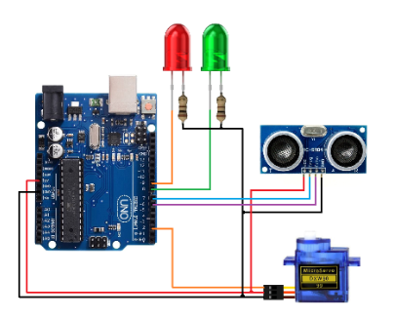
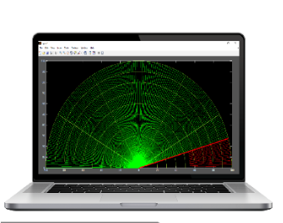
Arduino Radar circuit diagram:-

Slide 7
Software and IDE incorporated:
MATLAB
ARDUINO

Slide 8
MATLAB code:
clc;
clear all;
%Customize graph
figure('units','normalized','outerposition',[0 0 1 1]);
whitebg('black');
%Draw Scale Data
th = linspace(0,pi,1000);
R = 10:10:100;
for i=1:length(R);
x = R(i)*cos(th);
y = R(i)*sin(th);
plot(x,y,'Color', [0.603922 , 0.803922 , 0.196078] ,'LineWidth',1);
hold on;
end
%Draw Axis data
x0 = [0 100 0 0 0 0 ]; x1 = [0 100 86.60 50 -50 -86.60]; y0 = [0 0 0 0 0 0]; y1 = [100 0 50 86.60 86.60 50];

Slide 9
for i=1:length(x0);
hold on;
plot([x0(i),x1(i)],[y0(i),y1(i)] ,'Color', [0.603922 , 0.803922 , 0.196078],'LineWidth',2);
end
%Draw Sonar default data
for i=1:180
hold on;
[x, y] = pol2cart(i*0.0174532925, 100);
h(i) = plot([0,x],[0,y],'g','LineWidth',1);
end
%define serial port
s1 = serial('COM7');
s1.BaudRate=9600;
fopen(s1);

Slide 10
%Draw Sonar Data
while(1)
data = fscanf(s1);
[th, r] = strtok(data);
th = real(str2num(th));
r = str2num(r);
set(h(th),'color','r');
[x0, y0] = pol2cart(th*0.0174532925, 100);
[x, y] = pol2cart(th*0.0174532925, r);
set(h(th),'XData',[x0,x]);
set(h(th),'YData',[y0,y]);
m = plot([0,x0],[0,y0],'r','LineWidth',3);
drawnow
delete(m);
end

Slide 11
Arduino code:
#include <Servo.h>
Servo myservo;
#define echo 6 //Echo pin
#define trigger 7 //Trigger pin
#define G_led 8 // choose the pin for the Green Led
#define R_led 9 // choose the pin for the Red Led
int distance;
int degree;
void setup() { // put your setup code here, to run once
Serial.begin(9600);
myservo.attach(2); // declare Servo Motor as output

Slide 12
pinMode(echo, INPUT );// declare ultrasonic sensor Echo pin as input
pinMode(trigger, OUTPUT); // declare ultrasonic sensor Trigger pin as Output
pinMode(R_led,OUTPUT); // declare Red LED as output
pinMode(G_led,OUTPUT); // declare Green LED as output
delay(100);
}
void loop() {
for(degree=1; degree<180; degree+=1){
myservo.write(degree);
delay(80);
data();
}

Slide 13
}
void data(){
digitalWrite(trigger, LOW);
delayMicroseconds(2);
digitalWrite(trigger, HIGH);
delayMicroseconds(10);
long time = pulseIn(echo, HIGH);
distance = time / 28.5 / 2;
if(distance>100){distance = 100;}
if(distance>50){
digitalWrite(G_led, HIGH); // LED Turn On
digitalWrite(R_led, LOW); // LED Turn Off
}else{
digitalWrite(G_led, LOW); // LED Turn Off
digitalWrite(R_led, HIGH); // LED Turn On
}
Serial.print(degree); Serial.print( " "); Serial.println(distance);
}

Slide 14
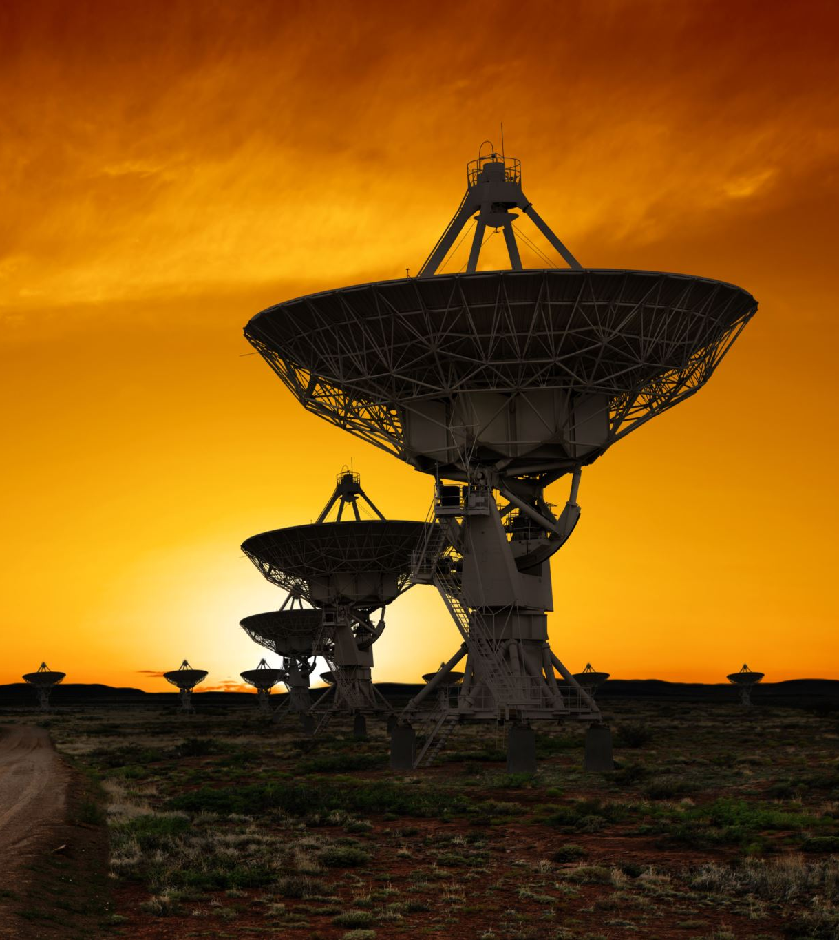
Applications of radar:
Military
Law enforcement
Space
Remote sensing of environment
Aircraft navigation

Slide 15
References
[1] G. Bhor, P. Bhandari, R. Ghodekar and S. Deshmukh, "Mini Radar," International Journal of Technical Research and Applications, pp. 68-71, 2016.
[2] D. B. Kadam, Y. B. Patil, K. V. Chougale and. S. S. Perdeshi, "Arduino Based Moving Radar System," International Journal of Innovative Studies in Sciences and Engineering Technology (IJISSET), vol. 3, no. 4, pp. 23-27,2017.
[3] T. P. Rajan, K. K. Jithin, K. S. Hareesh, C. A. Habeeburahman and. A. Jithin, "Range Detection based on Ultrasonic Principle," International Journal of Advanced Research in Electrical, Electronics and Instrumentation Engineering, vol. 3, no. 2, pp. 7638-7643, 2014.
[4] P. S. Abhay,. S. K. Akhilesh, P. Amrit and Kriti, "A Review on Ultrasonic Radar Sensor for Security system," Journal ofEmerging Technologies and Innovative Research (JETIR), pp.137-140, 2016.
[5] P. P. Arun, M. A. Sudhakar, P. MeghaSunil and S. S. Balaji,"Ultrasonic Distance Meter," SVERIAN Scientific, pp. 1-4,2015.
Wikipedia
Department of Electronics And Communication Engineering (NBA)

Slide 16

Thank you

